Slide 1
AI for Everyone
Presidential Initiative for Artificial Intelligence and Computing

Slide 2
1. What is AI?

Slide 3
Objectives of this Course
The meaning behind common AI terminology, including neural networks, machine learning, deep learning, and data science
What AI realistically can--and cannot--do
How to spot opportunities to apply AI to problems in your own organization
What it feels like to build machine learning and data science projects
How to work with an AI team and build an AI strategy in your company
How to navigate ethical and societal discussions surrounding AI

Slide 4
$13 Trillion
AI value creation by 2030
Source: McKinsey Global Institute

Slide 5
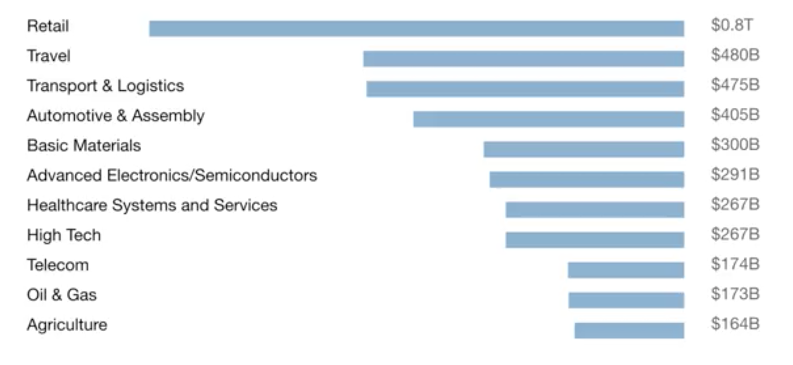
A lot of the value created by AI will be outside the software industry. AI will have a huge impact on all the major industries.

Slide 6
There are 2 types of AI
ALMOST NO PROGRESS
ANI
Artificial Narrow Intelligence
AGI
Artificial General Intelligence
LOTS OF PROGRESS
Notes:
There is a lot of excitement but also a lot of unnecessary hype about AI.
AI is actually two separate ideas.

Slide 7
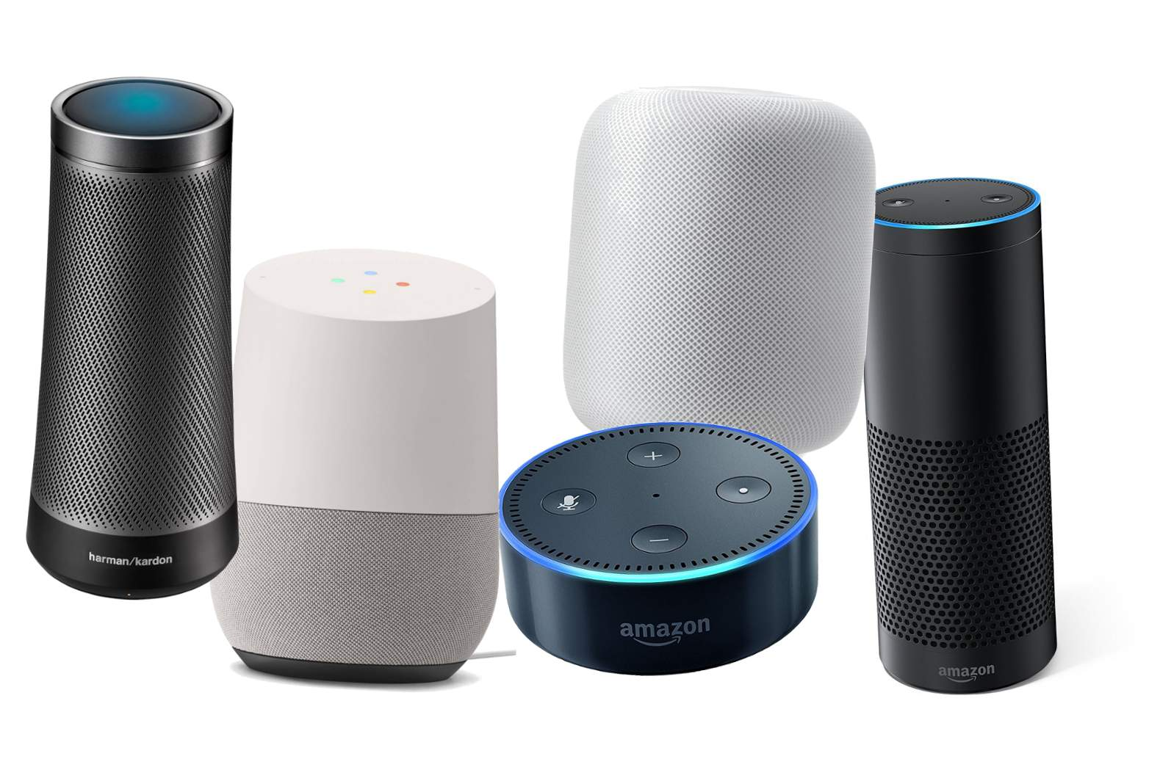
Artificial Narrow Intelligence (ANI)
These are AIs that do one thing such as:
smart speaker
self-driving car
AI to do web search
AI applications in farming or in a factory.
These types of AI are one trick ponies but when you find the appropriate trick, this can be incredibly valuable.

Slide 8

Artificial General Intelligence (AGI)
That is the goal to build AI.
They can do anything a human can do or maybe even be superintelligent and do even more things than any human can.

Slide 9
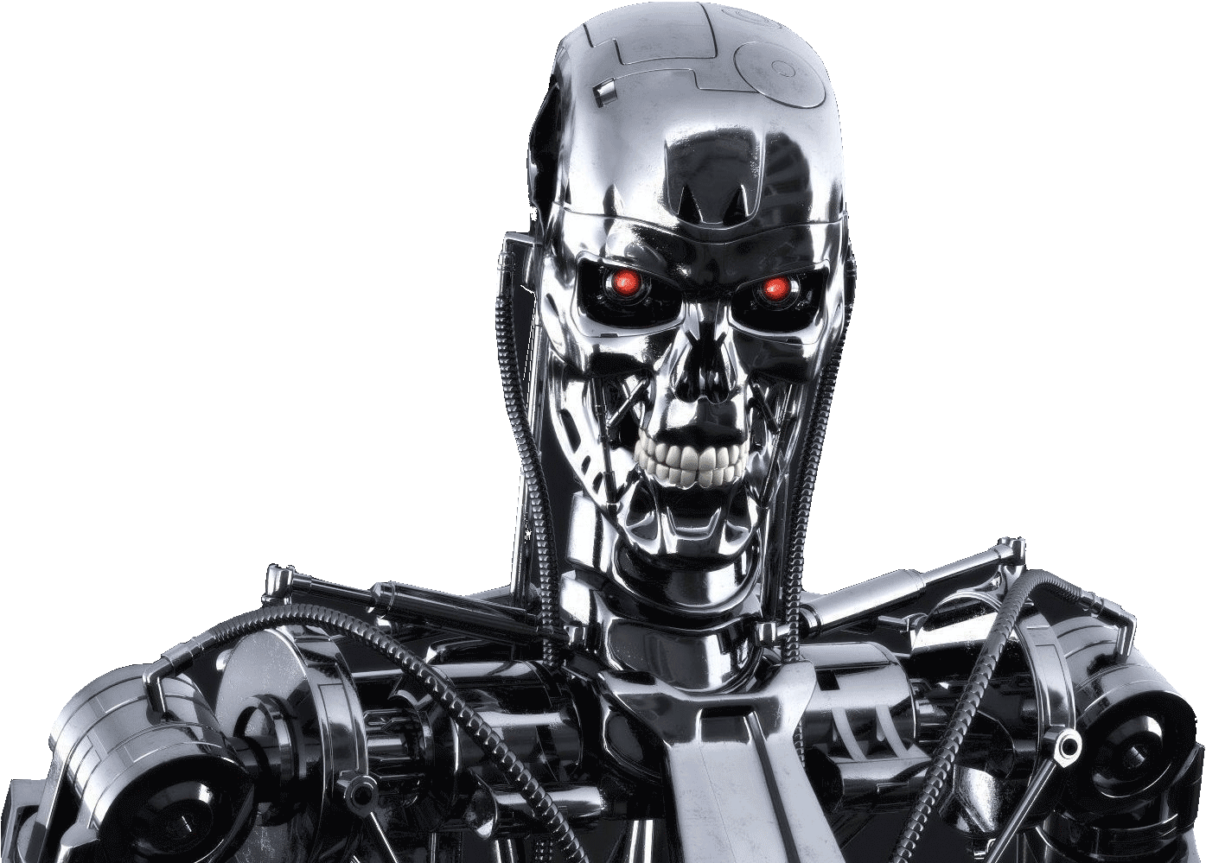
Progress in ANI vs AGI
The rapid progress in ANI has caused people to conclude that there's a lot of progress in AI, which is true. But that has caused people to falsely think that there might be a lot of progress in AGI as well which is leading to some irrational fears about evil clever robots coming over to take over humanity anytime now.

Slide 10
Achieving AGI Will Take Time
AGI is an exciting goal for researchers to work on, but it requires many technological breakthroughs before we get there and it may be decades or hundreds of years or even thousands of years away.

Slide 11
Machine Learning
The rise of AI has been largely driven by one tool in AI called machine learning.
You will start thinking how machine learning might be applied to your company or to your industry.

Slide 12



Supervised Learning
If the input is an audio clip, and the AI's job is to output the text transcript, then this is speech recognition.
Input (A)
Audio
Output (B)
Text (0/1)
Application
Speech Recognition

Slide 13



Supervised Learning
If you want to input English and have it output a different language, Chinese, Spanish, something else, then this is machine translation.
Input (A)
English
Output (B)
Chinese
Application
Machine Translation

Slide 14




Supervised Learning
All the large online ad platforms have a piece of AI that inputs some information about an ad, and some information about you, and tries to predict, will you click on this ad or not?
Input (A)
Ad + User Info
Output (B)
Click? (0/1)
Application
Machine Translation

Slide 15


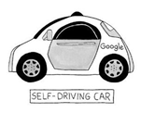

Supervised Learning
If you want to build a self-driving car, one of the key pieces of AI is the AI that takes as input an image, and some information from radar, or from other sensors, and outputs the position of other cars, so your self-driving car can avoid the other cars.
Input(A)
Image, radar info
Position of other cars
Self-Driving Car

Slide 16


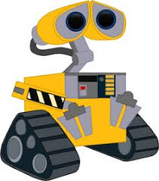
Supervised Learning
In Manufacturing, we take as input a picture of something you've just manufactured, such as a picture of a cell phone coming off the assembly line., and you want to output, is there a scratch, or is there a dent, or some other defects on this thing you've just manufactured? This is visual inspection which is helping manufacturers to reduce or prevent defects in the things that they're making.
Input (A)
Image of a phone
Output (B)
Defects (0/1)
Visual Inspection

Slide 17
Supervised Learning
This set of AI called supervised learning, just learns input to output, or A to B mappings. On one hand, input to output, A to B it seems quite limiting. But when you find a right application scenario, this can be incredibly valuable.

Slide 18
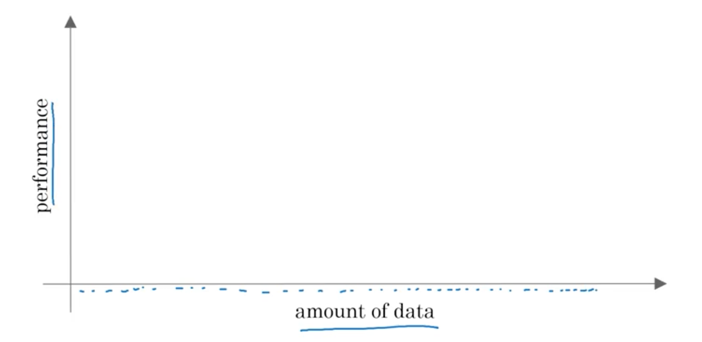
Why Now?

Slide 19
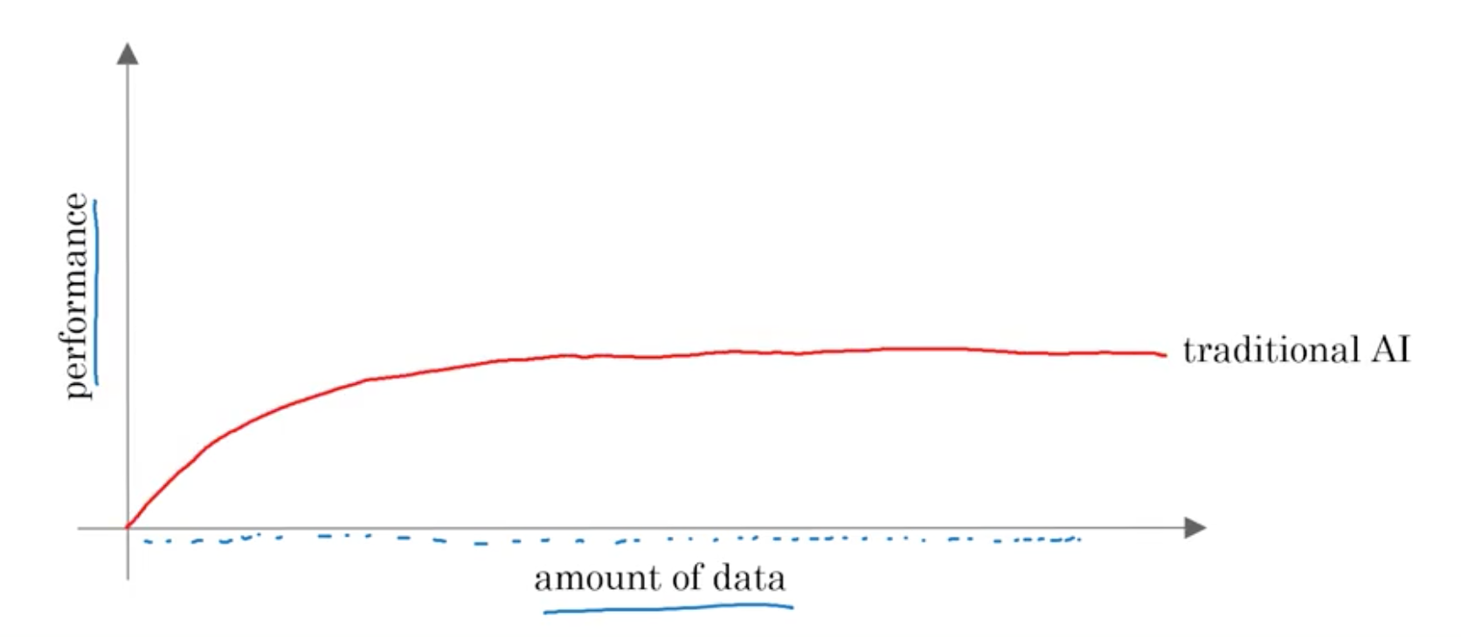
Why Now?

Slide 20
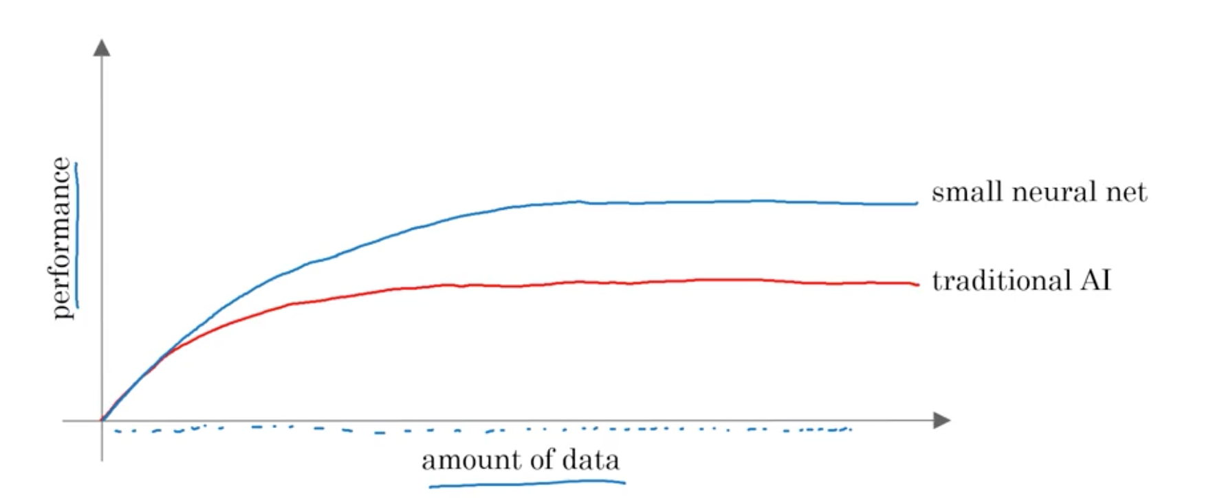
Why Now?

Slide 21
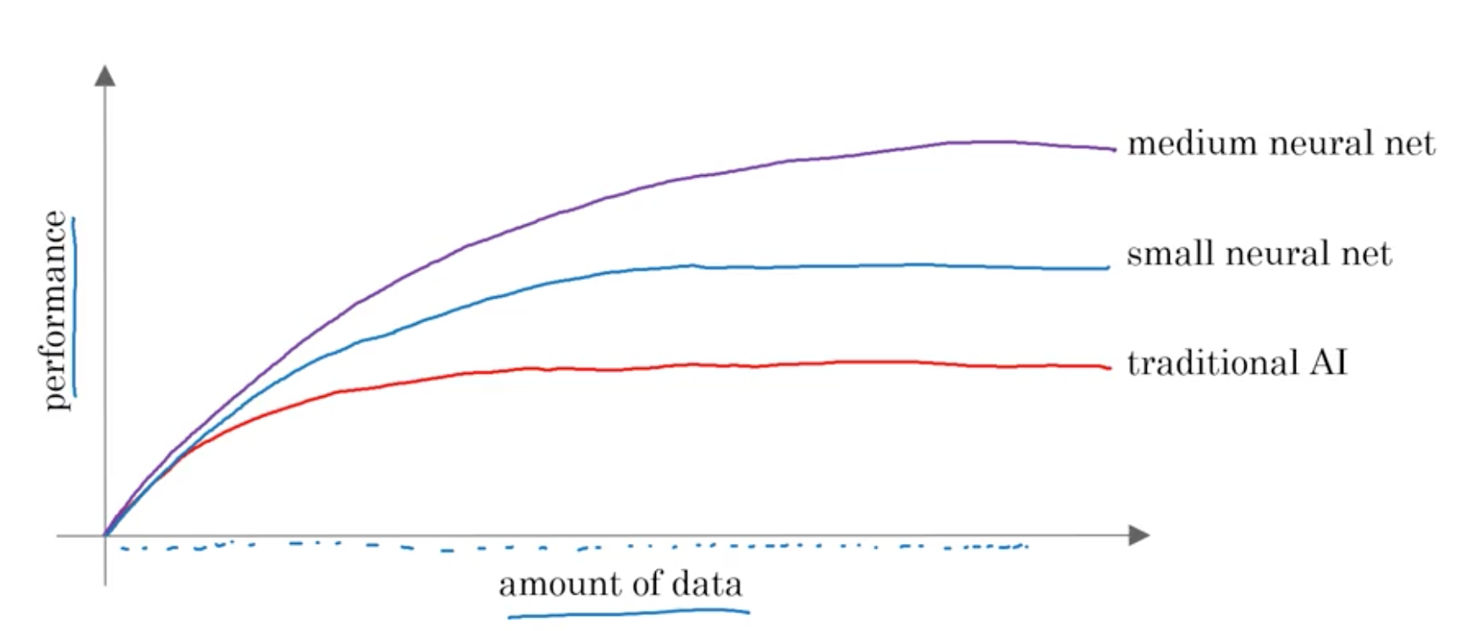
Why Now?

Slide 22
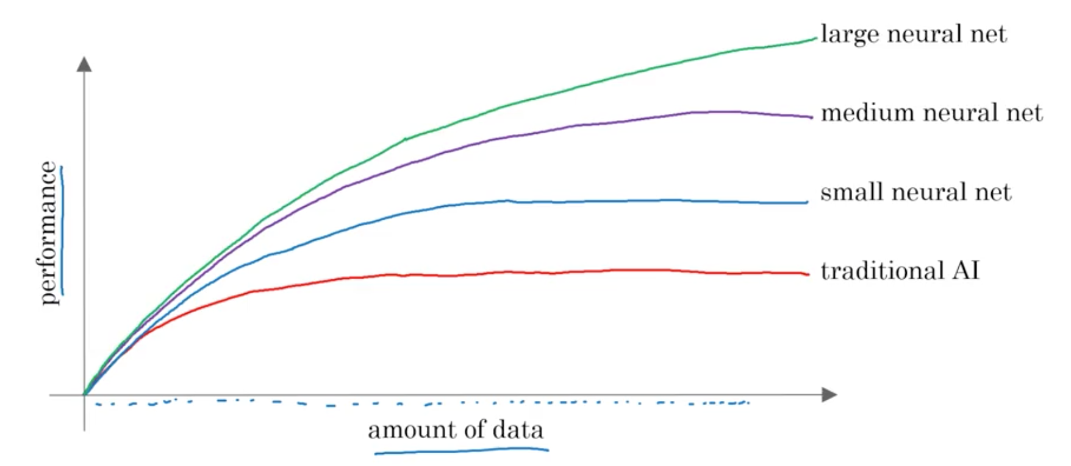
Why Now?

Slide 23
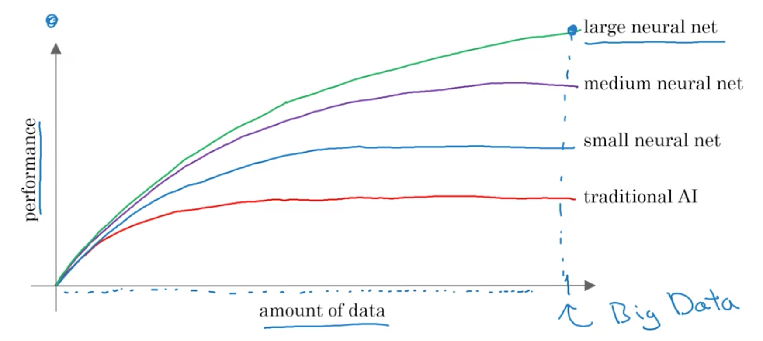
Why Now?

Slide 24
The Rise of Fast Computers
So, the rise of fast computers with specialized processors such as graphics processing units or GPUs has enabled many companies, not just giant tech companies, but many many other companies to be able to train large neural nets on a large enough amount of data in order to get very good performance and drive business value.

Slide 25
What is the most important idea in AI?

Slide 26
Machine Learning

Slide 27
What is Supervised Learning?

Slide 28
A to B mappings
Input to Output mappings

Slide 29
What enables machine learning to work so well?

Slide 30
What is Data

Slide 31
A Table of Data (Dataset)
Size of House (Square Feet) | Price ($1000)
523 | 115
645 | 150
708 | 210
1034 | 280
2290 | 355
2545 | 440
A | B

Slide 32
A Table of Data (Dataset)
Size of House (Square Feet) | # of Bedrooms | Price ($1000)
523 | 1 | 115
645 | 1 | 150
708 | 2 | 210
1034 | 3 | 280
2290 | 4 | 355
2545 | 4 | 440
A |  | B

Slide 33
Data is often unique to your business
Data is often unique to your business, and this is an example of a dataset that a real estate agency might have that they tried to help price houses.
It's up to you to decide what is A and what is B, and how to choose these definitions of A and B to make it valuable for your business.

Slide 34
Another example
If you have a certain budget and you want to decide what is the size of house you can afford, then you might decide that the input A is how much does someone spend and B is just the size of the house in square feet, and that would be a totally different choice of A and B that tells you, given a certain budget, what's the size of the house you should be maybe looking at.

Slide 35
A Table of Data (Dataset)
Size of House (Square Feet) | # of Bedrooms | Price ($1000)
523 | 1 | 115
645 | 1 | 150
708 | 2 | 210
1034 | 3 | 280
2290 | 4 | 355
2545 | 4 | 440
B |  | A

Slide 36

Acquiring data
Manual labeling

Slide 37
Acquiring data
From observing behaviors of humans
User ID | Time | Price ($) | Purchased
4783 | Jan 21 08:15.20 | 7.95 | yes
3893 | Mar 3 11:30.15 | 10.00 | yes
8384 | Jun 11 14:15.05 | 9.50 | no
0931 | Aug 2 20:30.55 | 12.90 | yes

Slide 38
Acquiring data
From observing behaviors of machines
Machine | Temperature | Pressure (psi) | Machine Fault
17987 | 60 | 7.65 | N
34672 | 100 | 25.50 | N
08542 | 140 | 75.50 | Y
98536 | 165 | 125 | Y
Input A |  |  | Input B

Slide 39
Acquiring data
Download from websites / partnerships
Thanks to the open internet you can find so many datasets available for free online
Computer vision or image datasets
Self driving car datasets
Speech recognition datasets
Medical imaging datasets
Keep in mind licensing and copyright

Slide 40


Use and misuse of data
Give me three years to build up my IT team, we're collecting so much data.
Then after three years, I'll have this perfect dataset.
We'll do AI then.
What’s wrong with this approach?

Slide 41
Use and misuse of data
It turns out that's a really bad strategy.
Once you've started collecting some data, go ahead and start showing it or feeding it to an AI team.
Then the AI team can give feedback to your IT team on what types of data to collect and what types of IT infrastructure to keep on building.

Slide 42
Example
Maybe an AI team can look at your factory data and say, "Hey. You know what? If you can collect data from this big manufacturing machine, not just once every ten minutes, but instead once every one minute, then we could do a much better job building a preventative maintenance systems for you.”
Machine | Temperature | Pressure (psi) | Machine Fault
17987 | 60 | 7.65 | N
34672 | 100 | 25.50 | N
08542 | 140 | 75.50 | Y
98536 | 165 | 125 | Y
Input A |  |  | Input B

Slide 43
Use and misuse of data
"Hey, I have so much data. Surely, an AI team can make it valuable."
What’s wrong with this statement?

Slide 44
Use and misuse of data
Unfortunately, this doesn't always work out.
More data is usually better than less data, but I wouldn't take it for granted that just because you have many terabytes or gigabytes of data, that an AI team can actually make that valuable.
Don't throw data at an AI team and assume it will be valuable.

Slide 45
Data is Messy
Not a cat
Not a cat
Cat
Cat

Slide 46

Data is Messy
If you have bad data, then the AI will learn inaccurate things.
Data problems:
Incorrect labels
Missing values
Multiple types of data
Unstructured Data: Images, audio, text

Slide 47
Size of House (Square Feet) | # of Bedrooms | Price ($1000)
523 | 1 | 115
645 | 1 | 0.001
708 | unknown | 210
1034 | 3 | unknown
unknown | 4 | 355
2545 | unknown | 440
Example
You can have incorrect labels or just incorrect data. For example, this house is probably not going to sell for $0.1 just for one dollar.
Or, data can also have missing values such as we have here a whole bunch of unknown values.
This is structured data.

Slide 48
Machine Learning vs Data Science
Size of House (Square Feet) | # of Bedrooms | # of Bathrooms | Newly Renovated | Price ($1000)
523 | 1 | 2 | N | 115
645 | 1 | 3 | N | 150
708 | 2 | 1 | N | 210
1034 | 3 | 3 | Y | 280
2290 | 4 | 4 | N | 355
2545 | 4 | 5 | Y | 440
A |  |  |  | B
Notes:
Mobile App to help people price houses
Machine Learning system: A > B

Slide 49
Running AI System
A software that which automatically returns output B for input A.
If you have an AI system running, serving dozens or hundreds of thousands or millions of users, that's usually a machine-learning system.

Slide 50
Data Science
If you want to have a team analyze your dataset in order to gain insights. The output of a data science project is a set of insights that can help you make business decisions
So, a team might come up with conclusions like:
"Hey, did you know if you have two houses of a similar size, they've a similar square footage, if the house has three bedrooms, then they cost a lot more than the house of two bedrooms, even if the square for this is the same."

Slide 51
Data Science
"Did you know that newly renovated homes have a 15% premium, and this can help you make decisions such as, given a similar square footage, do you want to build a two bedroom or three bedroom size in order to maximize value? "
"Is it worth an investment to renovate a home in the hope that the renovation increases the price you can sell a house for?"
The output of a data science project is a set of insights that can help you make business decisions, such as what type of house to build or whether to invest in renovation.

Slide 52
Machine Learning vs Data Science
Machine Learning
“Field of study that gives computers the ability to learn without being explicitly programmed.”
Arthur Samuel (1959)
A machine learning project will often result in a piece of software that runs, that outputs B given A.

Slide 53
Formal Definition of Data Science
Data science is the science of extracting knowledge and insights from data.
So, the output of a data science project is often a slide deck, the presentation summarizes conclusions for executives to take business actions or summarizes conclusions for a product team to decide how to improve a website.

Slide 54
Example of ML vs DS in the online ad industry
Large platforms have AI that quickly tells them what’s the ad you’re most likely to click on. This is a machine learning system. It inputs information about the user and about the ad and outputs whether the user will click on the ad or not.
These systems run 24/7 and drive ad revenue for these platforms.

Slide 55
Example of ML vs DS in the online ad industry
If analyzing data tells you, for example, that the travel industry is not buying a lot of ads, but if you send more salespeople to sell ads to travel companies, you could convince them to use more advertising, then that would be an example of a data science project.
The data science conclusion results in the executives deciding to ask a sales team to spend more time reaching out to the travel industry.

Slide 56
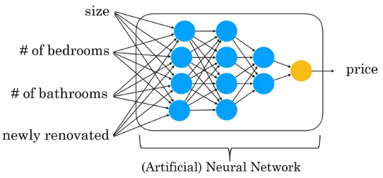
Deep Learning

Slide 57
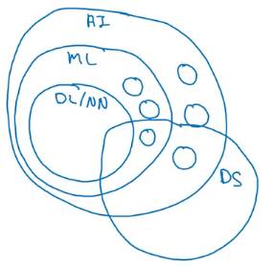
AI and related disciplines
Machine Learning
Data Science
Deep Learning / Neural Network
Supervised Learning
Un supervised learning
Reinforcement Learning

Slide 58
What makes a company AI company?
Strategic data acquisition
Unified datawarehouse
Pervasive automation
New roles such as MLE

Slide 59
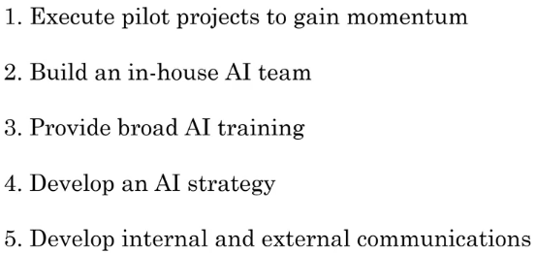
AI Transformation

Slide 60
Deciding about a new project
Technical diligence
Is it feasible project?
Can AI do that?
Pretty much any thing you can do with a second of thought can be automated using supervised learning

Slide 61
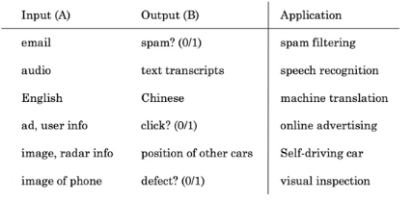
Supervised learning tasks

Slide 62
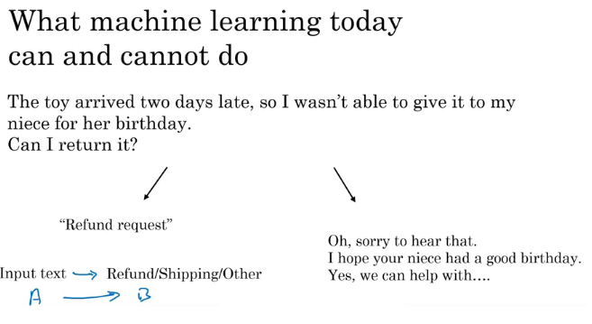

Slide 63
Examples of what ML can and can’t do?
Identifying the intent of the customer - Possible
Writing an emphatic response to customer’s email – Not possible or difficult

Slide 64
Technical diligence rules
You are learning a simple concept
Do you have large training data

Slide 65
More examples
Self driving car
Input is from sensors, camera
Output where are the other cars
Recognizing gesture of traffic police, construction work, people– not possible
Critical application requires good accuracy

Slide 66
X-ray diagnosis
Diagnosing a disease from X-ray images– possible
Diagnosing a disease after reading a book

Slide 67
Strengths and weakness of ML
Works when,
Learning a simple concept
Lots of data available
Doesn’t work when,
Learning a complex concept
Asked to work on new type of data such as X-ray images in different conditions and angles

Slide 68
Demand prediction based on price
Price -> Demand can be modeled using a neural network using a neuron
(Perceptron model)
Network of neurons (ANN)
Price
Shipping Cost
Marketing
Meterial

Slide 69
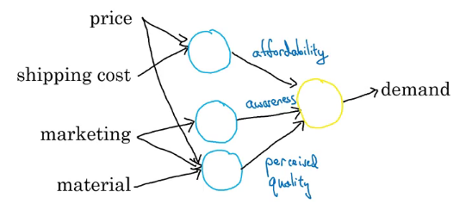

Slide 70
Face recognition
Pictures comprise pixels
Color images and channels
A neural network corresponds to pixels
Earlier layers will detect edges, then lobes and then objects

Slide 71
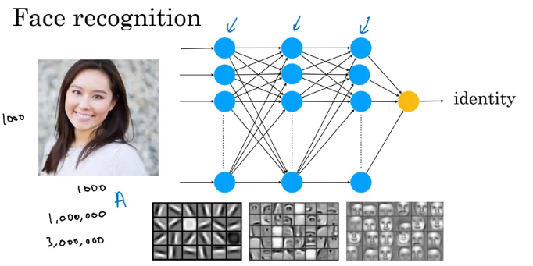

Slide 72
2.Building AI Projects
Work flow of a machine learning project
Workflow of a data Science Project
Organizing data and the team for the projects

Slide 73
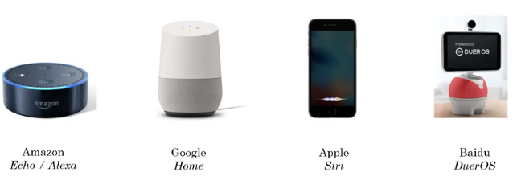
Speech Recognition

Slide 74
Key steps of Echo / Alexa
Collect data
Labelled voice
Train model
Iterate many times
Deploy the model
Get more data and update model

Slide 75
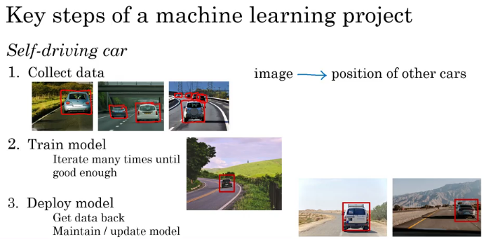

Slide 76
Workflow of a data science project
Unlike a machine learning project, the output of a data science project is often a set of actionable insights, a set of insights that may cause you to do things differently.
Data science projects have a different workflow than machine learning projects.

Slide 77
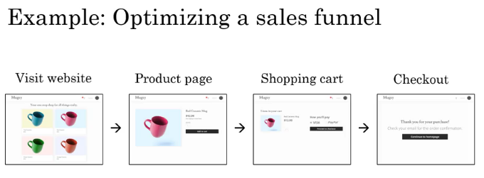

Slide 78
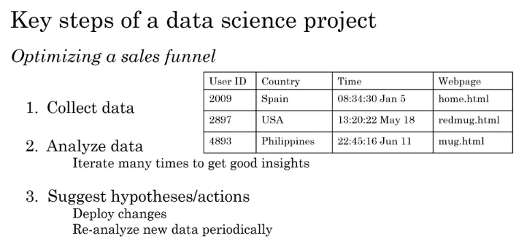

Slide 79
Machine Learning changing job functions
Sales
Identifying sales opportunities
Prioritizing
Manufacturing line manager
Optimize manufacturing
Machine learning can spot defects
Recruiting
Identify how people prefer recruitment
Spot good candidates

Slide 80
Marketing
Optimize website
A/B testing
Recommendation system
Agriculture
What to plant?
Precision agriculture

Slide 81
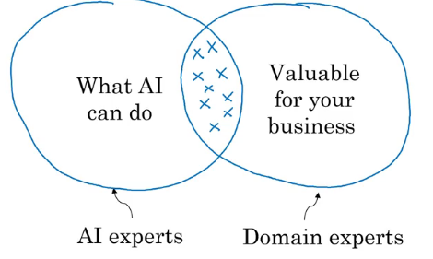
How to chose an AI project?

Slide 82
Brainstorming framework
Automate task rather than job
Automating call center: picking phone, emails, issue refund, call routing
Automating radiologist: X-ray, mentoring other doctors, consulting,
Main drivers of business value
What are the main pain points in your business?

Slide 83
Is it always necessary to have big data?
Having more data is good
With small datasets you can make progress
10, 100 or 1000 data points can be a good start

Slide 84
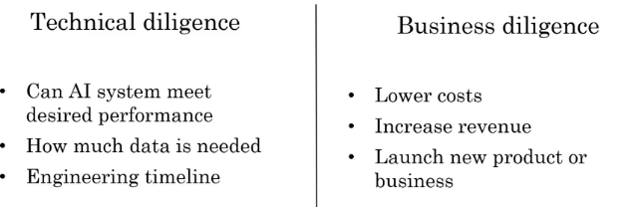

Slide 85
Ethical diligence
Is this going to make society better?

Slide 86
Build Vs Buy
ML projects can be inhoused or outsourced
DS projects are generally inhoused
Buy industry standard, only build specialized products

Slide 87
How to work with AI team
Specify your acceptance criteria
95% accuracy
Training, validation and Test dataset
Don’t expect 100% accuracy
Limitations of ML
Insufficient data
Mislabeled data
Ambiguous labels (human perception)

Slide 88
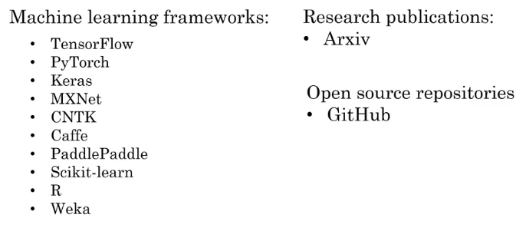
Machine Learning frameworks

Slide 89
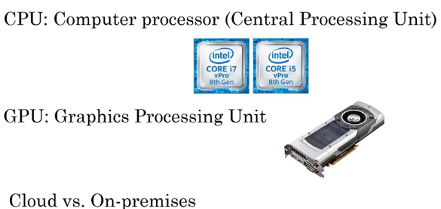
CPU Vs GPU
Edge Deployment

Slide 90
3. Ai in your company

Slide 91
Case Studies

Slide 92
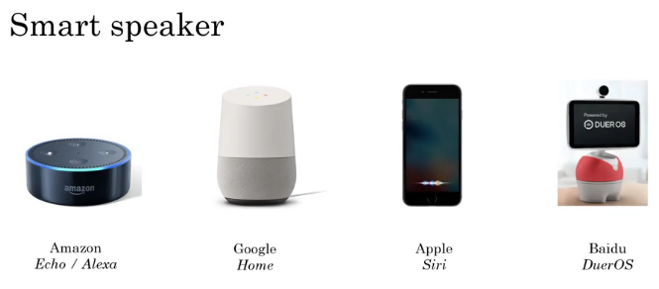

Slide 93
Different Calls to device:
Hey Device Tell me joke
Hey device tell me something funny
Hey Device do you know some joke
Hey Device what is funny today
Etc etc
But device can recognize the intent easily in all these

Slide 94
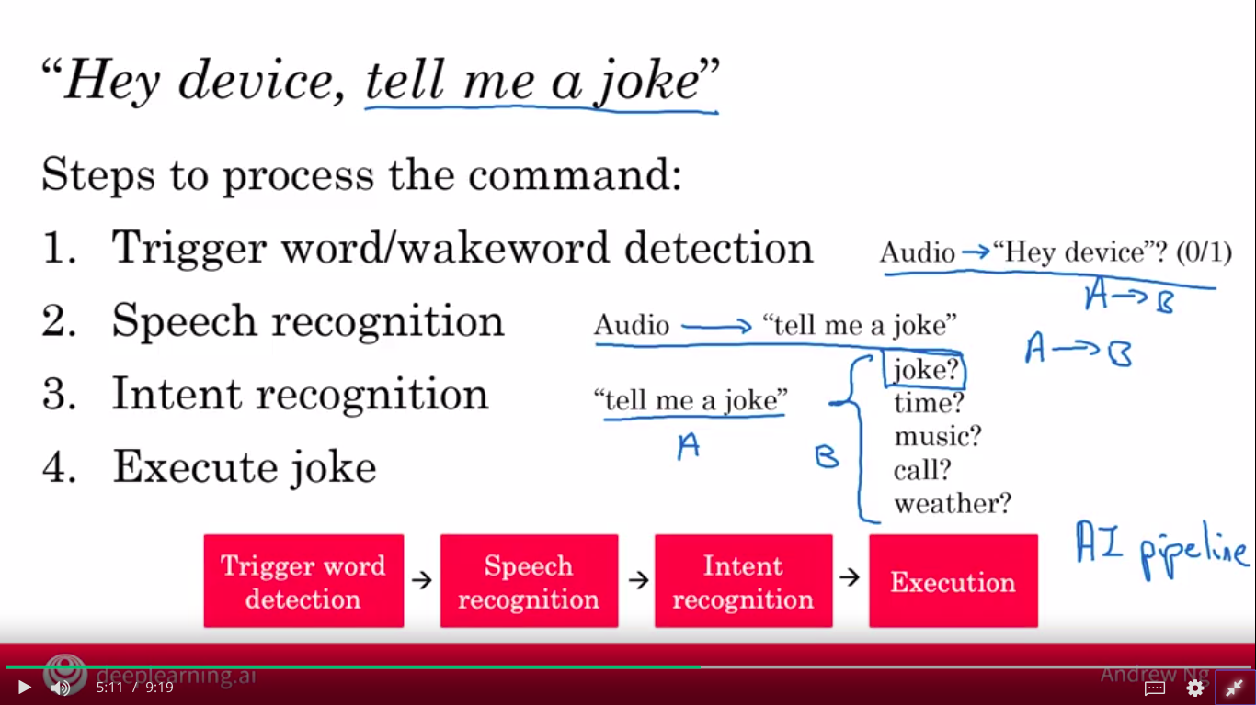

Slide 95
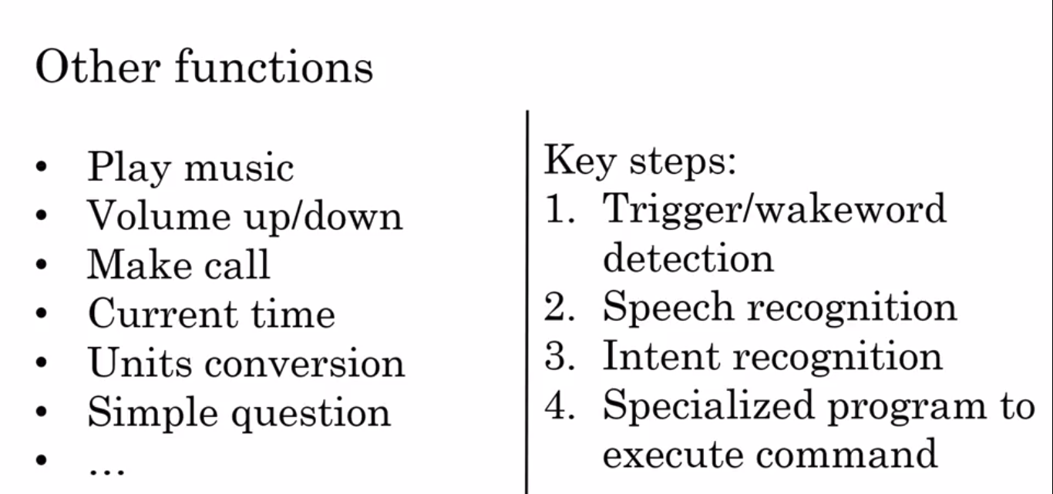
These specialized execution routines are written by software engineer

Slide 96
Activity
Hey device, set timer for 10 minutes
What is the intent?
Extract duration
What command is to execute

Slide 97
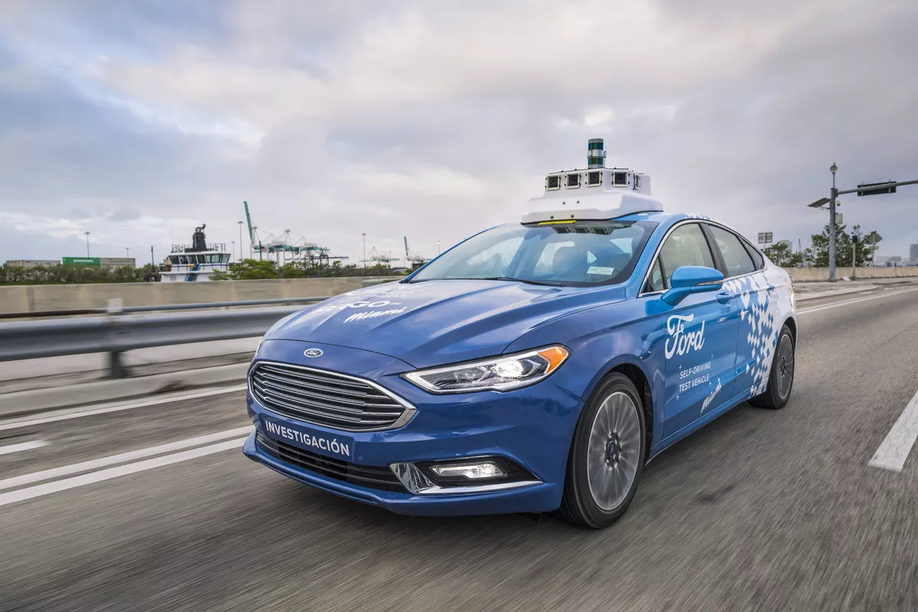
Self Deriving Car

Slide 98
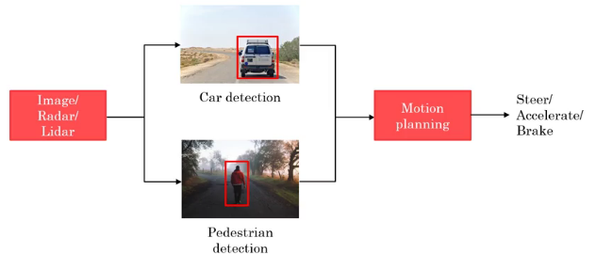
How does it works:

Slide 99
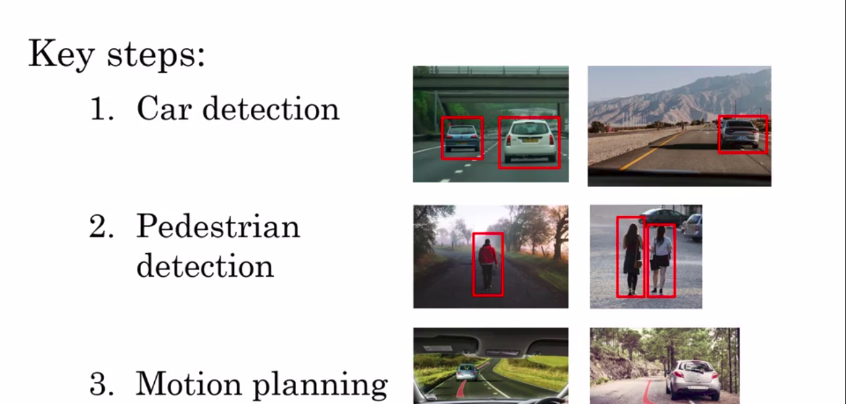

Slide 100
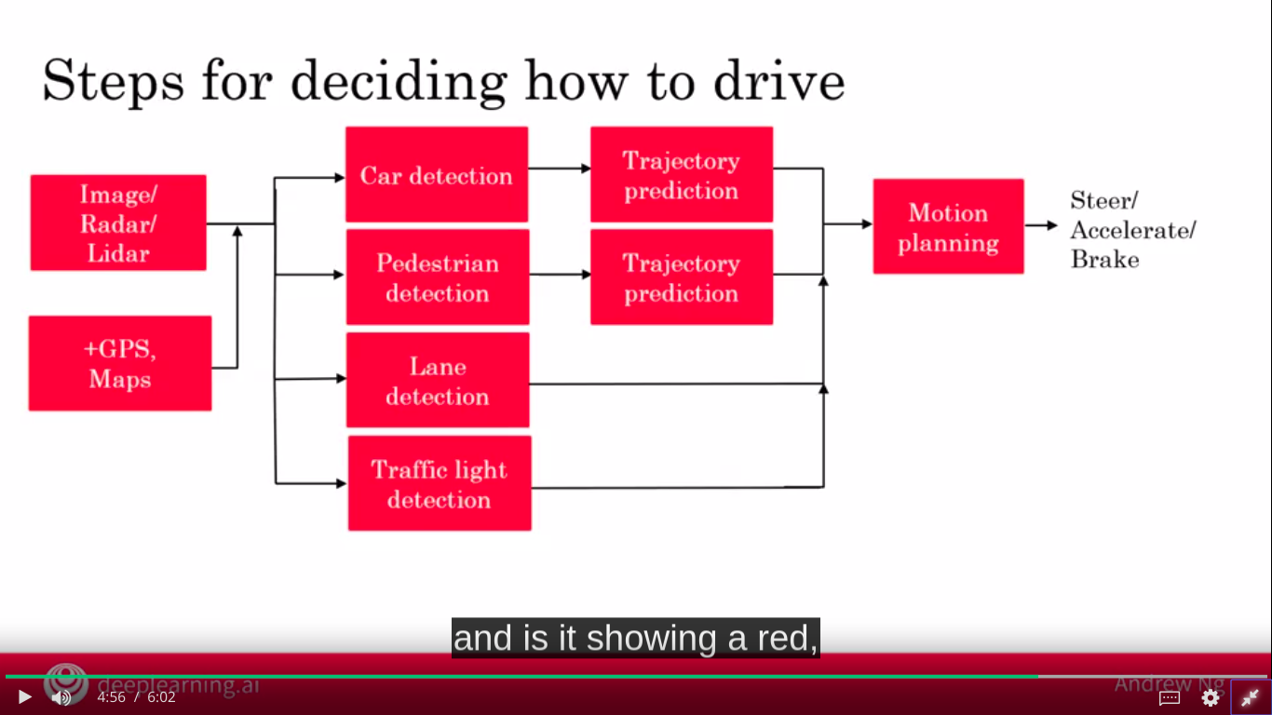

Slide 101
Example Roles of large AI Teams:
AI team may have 100s of engineers
A small team can have four or five members
Example roles
Software Engineers
Execute joke, Set timer
Machine Learning Engineer
Machine Learning Researcher
Extend state-of-the-art
Applied ML scientist in between ML researcher and ML Engineer

Slide 102
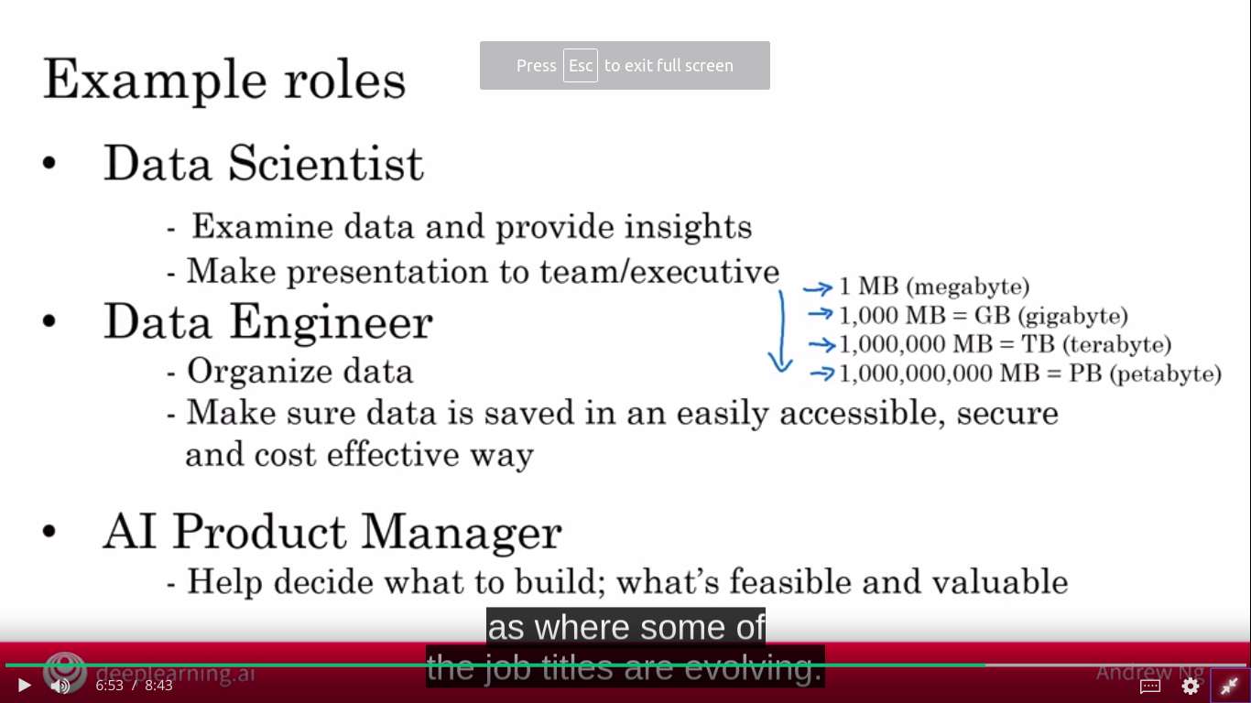

Slide 103
Get started with a small team
1 Software engineer
1 ML engineer / Data scientist
No body but your self

Slide 104
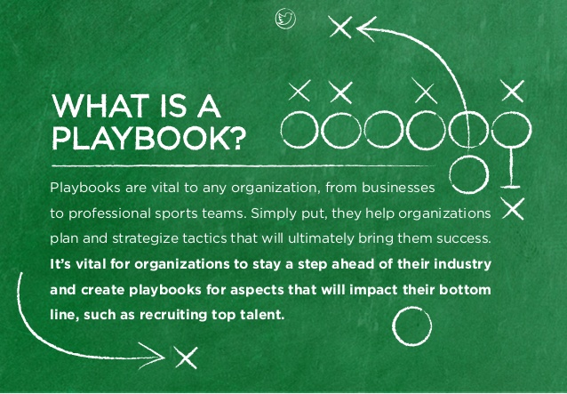
AI Transformation playbook

Slide 105
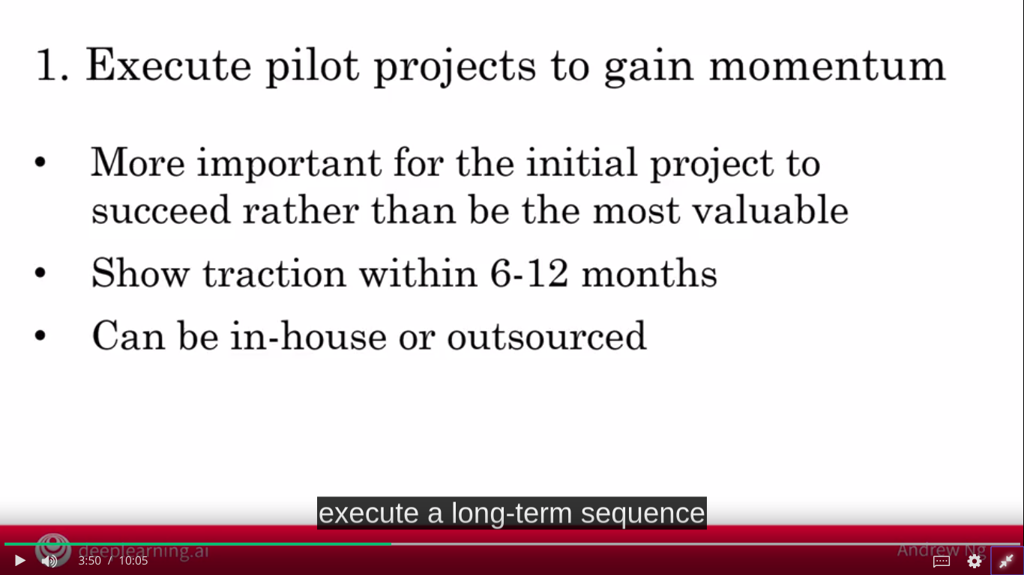
AI Transformation playbook

Slide 106
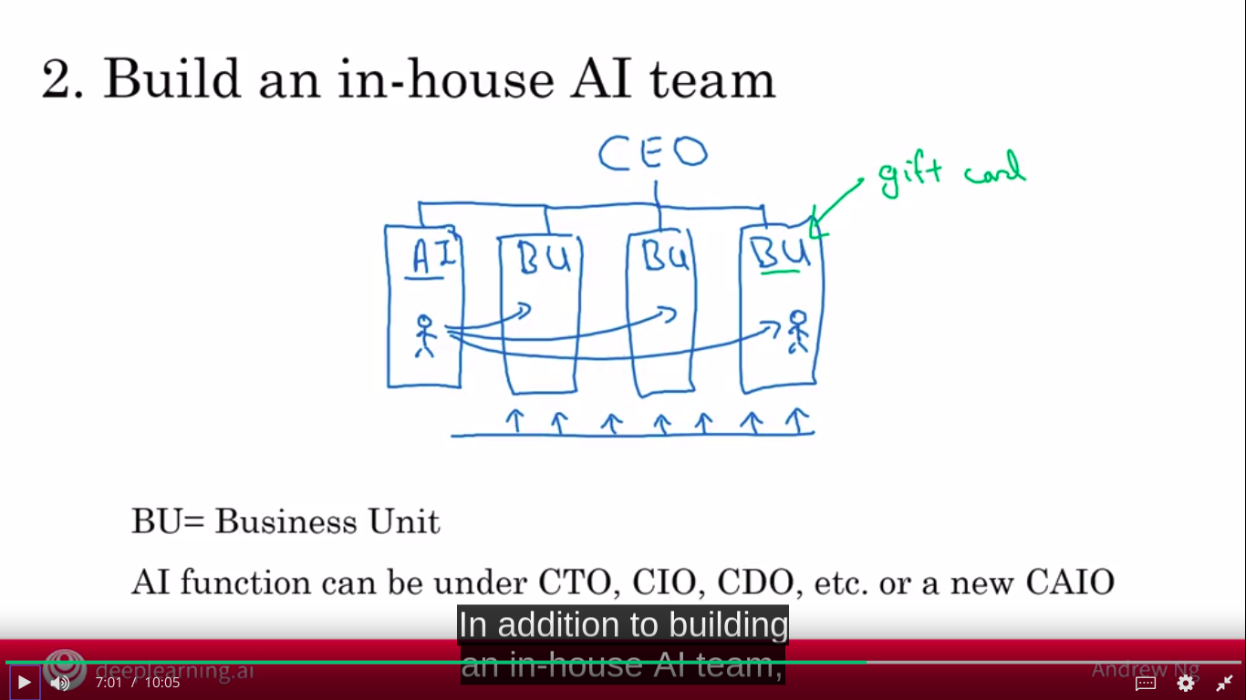
AI Transformation playbook

Slide 107
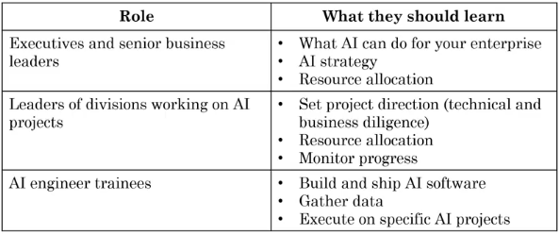
AI Transformation playbook
3. Provide broad AI training
Resources
Online courses
Books
Curate rather than create content

Slide 108
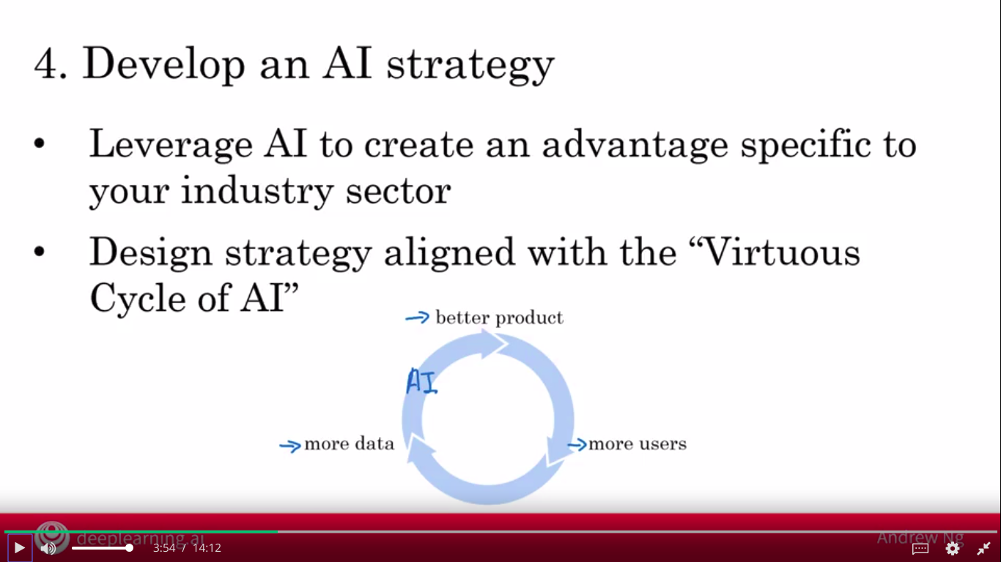
AI Transformation playbook
AI needs to be specialized or verticalized to your industry sectory
Don’t compete with giants

Slide 109
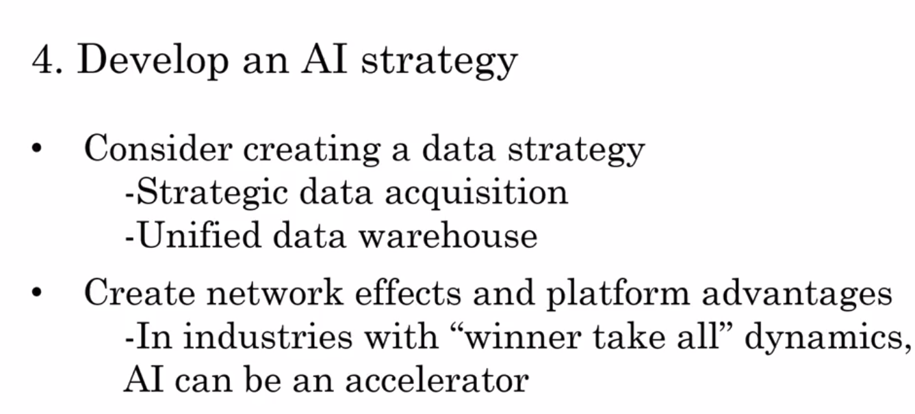
AI Transformation playbook

Slide 110
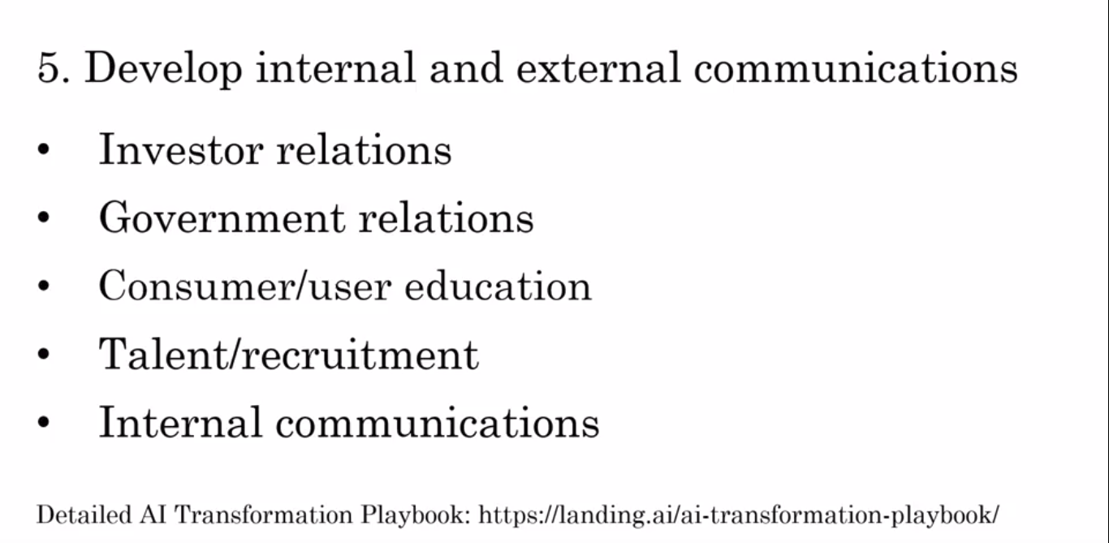
AI Transformation playbook

Slide 111

AI Pitfalls

Slide 112
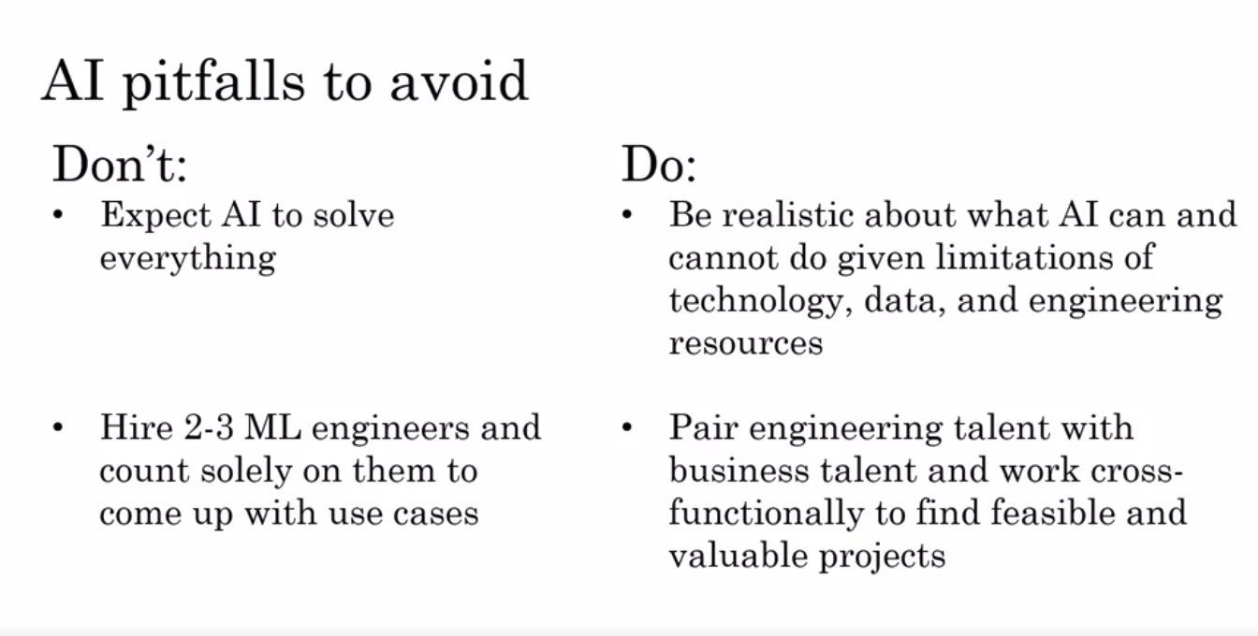
AI Pitfalls

Slide 113
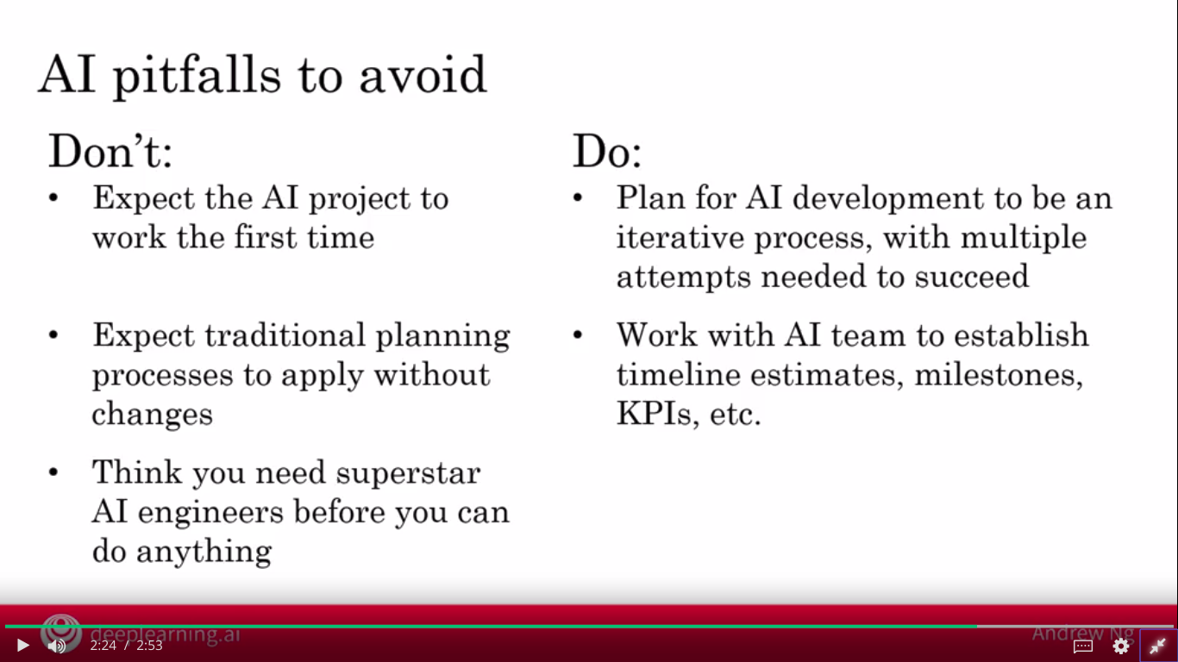
AI Pitfalls

Slide 114
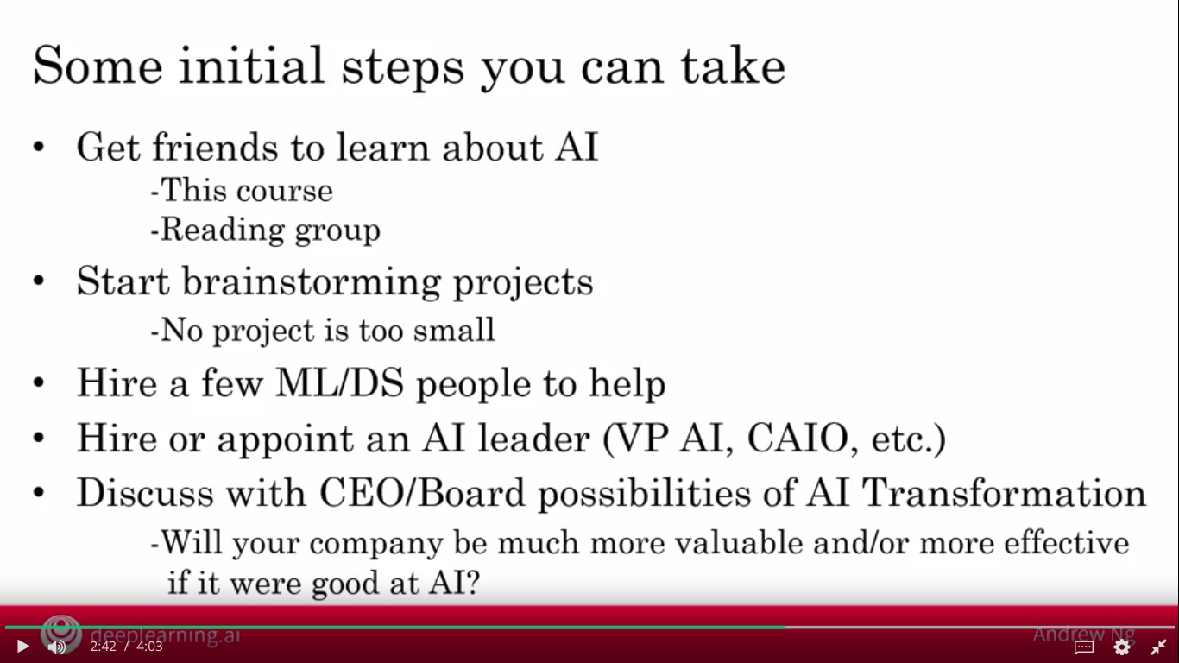

Slide 115
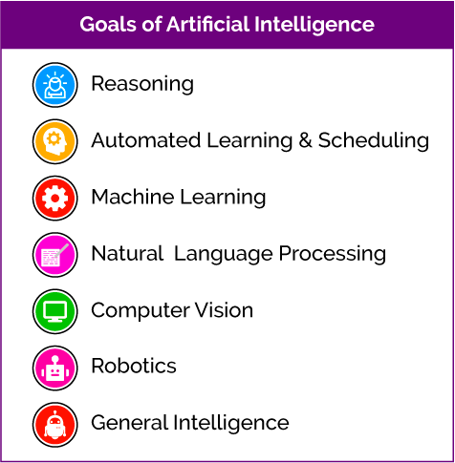
Major Artificial Intelligence Application Areas

Slide 116
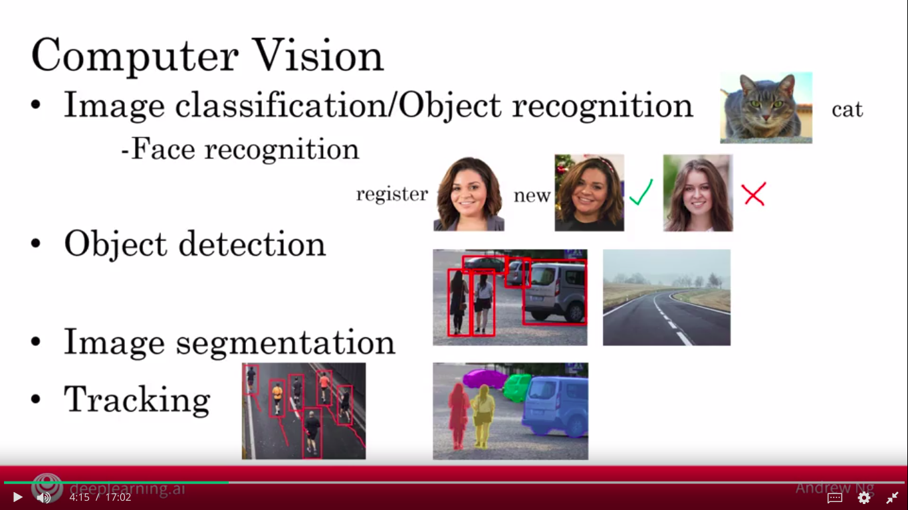
AI Application areas

Slide 117
AI Application areas

Slide 118
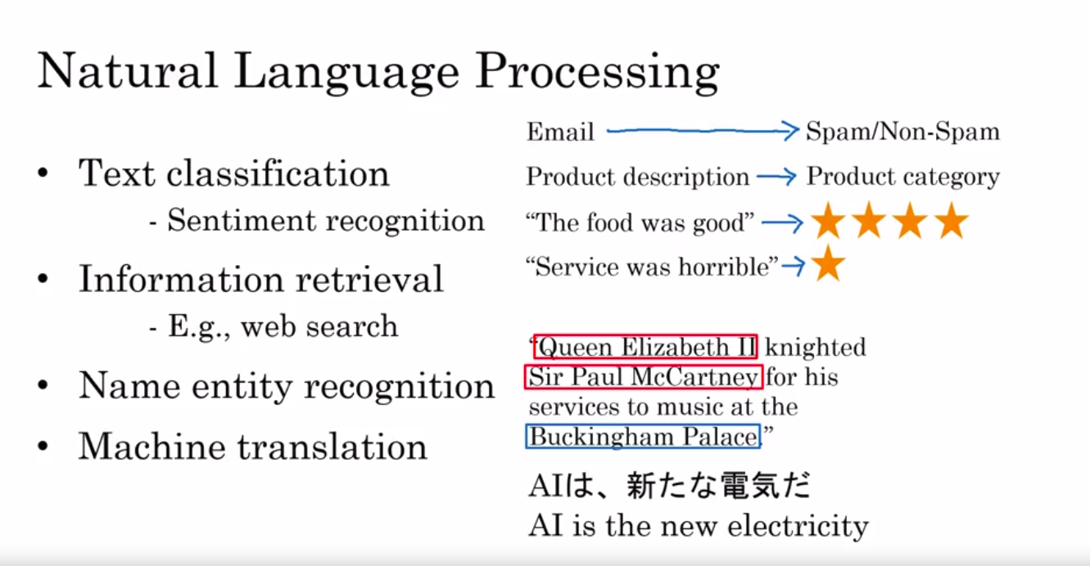
AI Application areas

Slide 119
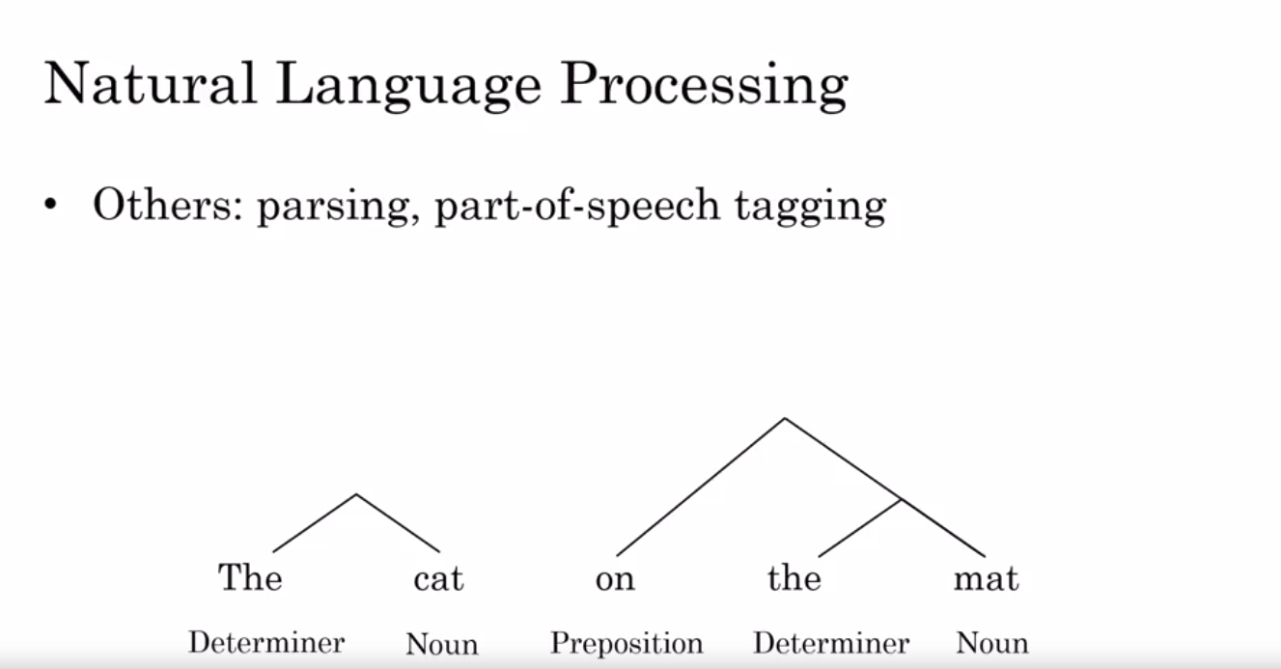
AI Application areas

Slide 120
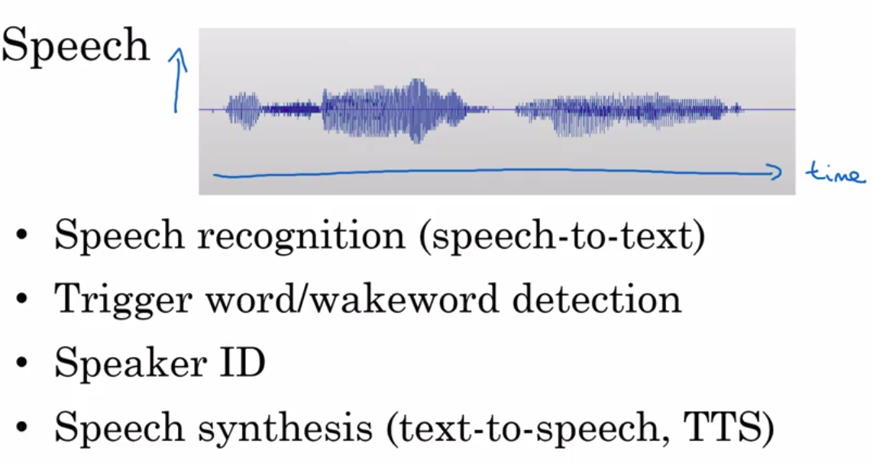
AI Application areas
Natural Language Processing

Slide 121
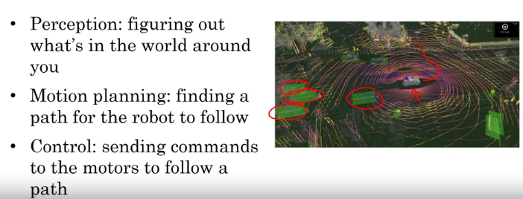
AI Application areas
Robotics

Slide 122

AI Application areas
General machine learning

Slide 123

Other AI Techniques
The value today of unsupervised
learning is so a lot smaller than
the value created through
supervised learning

Slide 124

Other AI Techniques

Slide 125

Other AI Techniques
Despite the huge amount of media attention on reinforcement learning, at least today it is creating significantly less economic value than supervised learning.
But there may be breakthroughs in the future that could change that.
And AI is advancing so rapidly that all of us certainly hope that there will be breakthroughs in all of these areas that we're talking about.

Slide 126

Other AI Techniques
Generative Adversarial Network (GAN)
Synthesize new images from scratch.
Entertainment industry, film, animation

Slide 127


Slide 128

Ai & Society
A realistic view of AI

Slide 129

Ai & Society
Biased through biased data
Adversarial attacks

Slide 130

Ai & Society

Slide 131

Ai & Society

Slide 132

Ai & Society
There is a minor change in pixel values of the picture
This change is almost imperceptible change to us humans
AI system sees the world very differently.

Slide 133

Ai & Society
A group at Carnegie Mellon University was able to design a funky pair of glasses like this. So, that when does man wears this pair of glasses, he can fool an AI system into thinking that he is actress Milla Jovovich.
Researchers from University of Michigan showed that if you affects stickers like these onto a stop sign, you can fool an AI system into not seeing the stop sign at all. It thinks there's something else there other than a stop sign. One interesting thing about this example is that most humans will still see this as a stop sign quite easily. But if you have a computer vision system built into a self-driving car for example, it would be really unfortunate if the car doesn't see the stop sign anymore, because of these stickers applied on top of it.

Slide 134



Slide 135
AI & Developing economy
“Every time there is a major technological disruption such as of AI, it gives us a chance to remake the world. AI is a very advanced technology, yes affecting both developed economies and developing economies.”

Slide 136
AI & Developing economy
Developing economies gradually moved up the ladder
Lower end ladder are susceptible to automation such as agriculture
Trampoline to move higher rungs
Leapfrog
Example of mobile phone
Mobile payments
Online education

Slide 137

AI & Developing economy

Slide 138


Slide 139



Slide 140


Slide 141

Some solutions to counter AI impact on jobs

Slide 142


Slide 143


